Slide 1
The Problem:
Predict User Demographic by Mobile Data
User Demographics:
‘‘gender’’, ‘‘job type’’, ‘‘marital status’’, ‘‘age’’ … Yet not available for most users due to privacy settings
Applications:
Personalize service
Advertisement targeting
Improve app performance

Slide 2
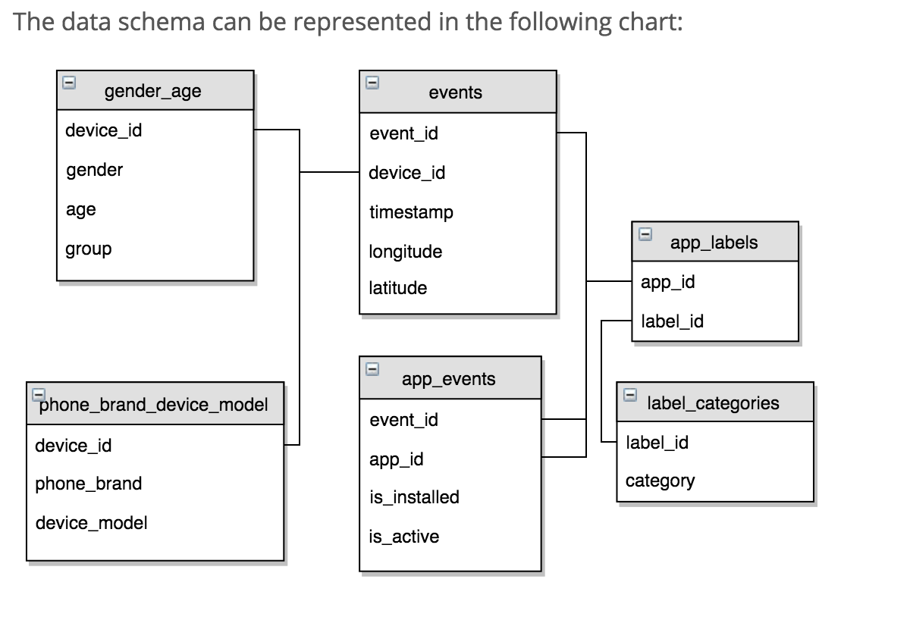

Slide 3
Questions to be answered:
Analysis:
What’s the overall market share for each phone brand, by gender and by age?
How to analyze user activities by age, gender, geographic location
What’s the spatial distribution of the users and events?
Prediction:
Predict user demographics, including “gender” and “age”, for each device in test data sets.
Possible solution:
mpl_toolkits.basemap for mapping events and users
XGBOOST for predicting user demographics

